Slide 1
Pricing and Setting Usage Limits for OpenAI
Making an AI Application with OpenAI API

Slide 2
Why set usage limits?
Don’t want to be surprised by a big bill
OpenAI API charges per use. Can grow quickly
Pricing can grow quickly if your application goes viral

Slide 3
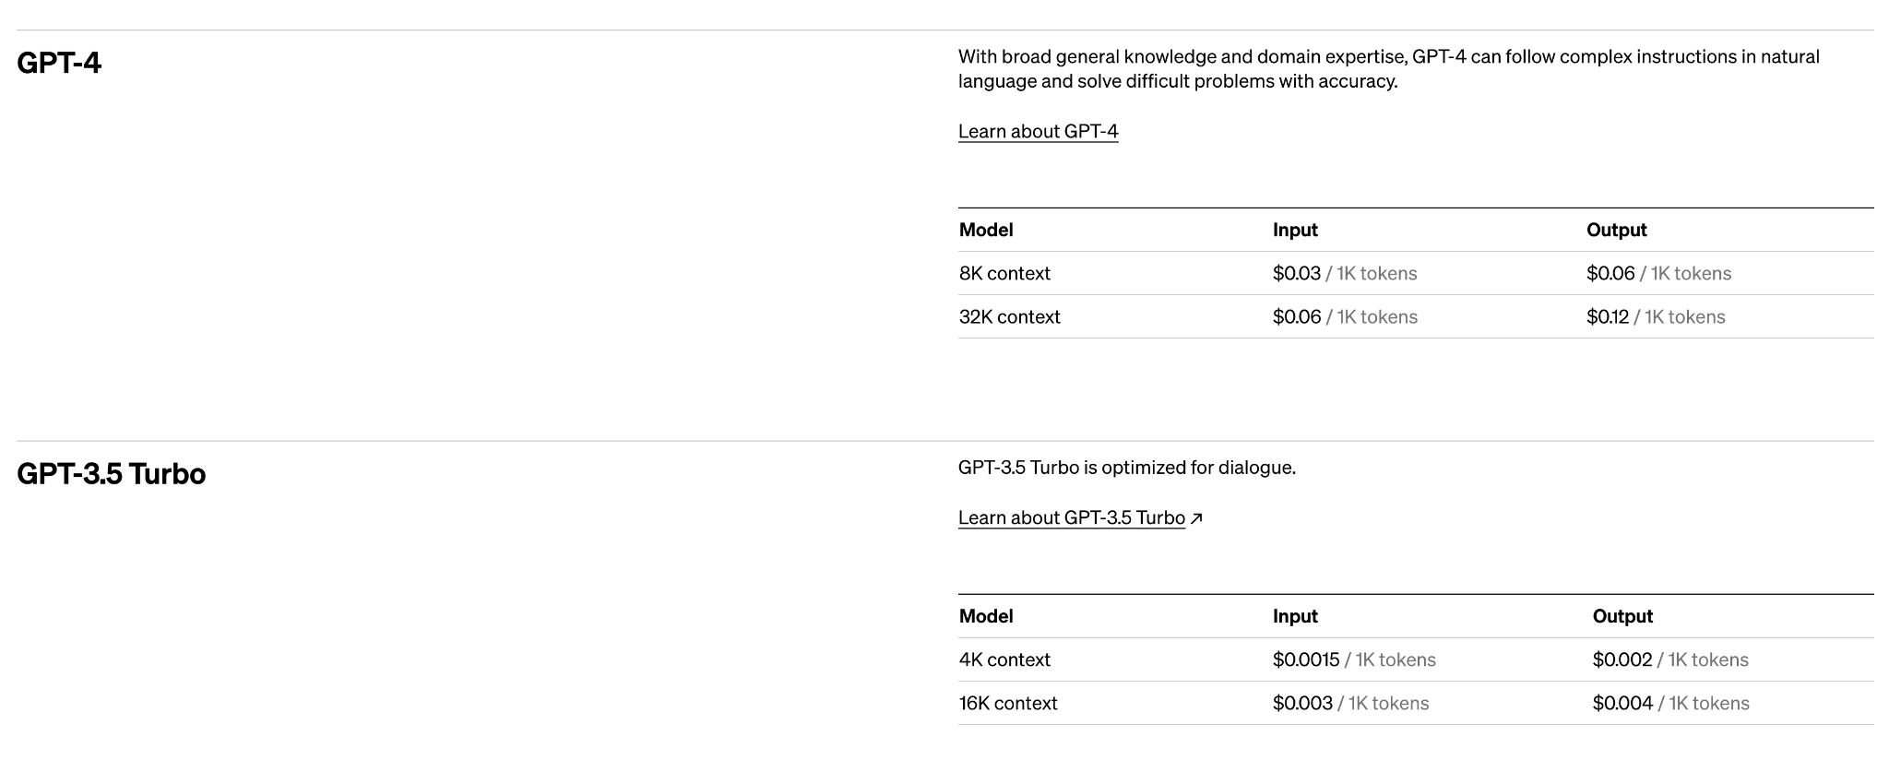
Current Pricing
As of 7/23/23
1 token = 1 word
For GPT 3.5 4k Context
For 10,000 words in and out, it costs $0.035
For 100,000 words in and out it costs for $0.35
For 1,000,000 words in and out it costs $3.5

Slide 4
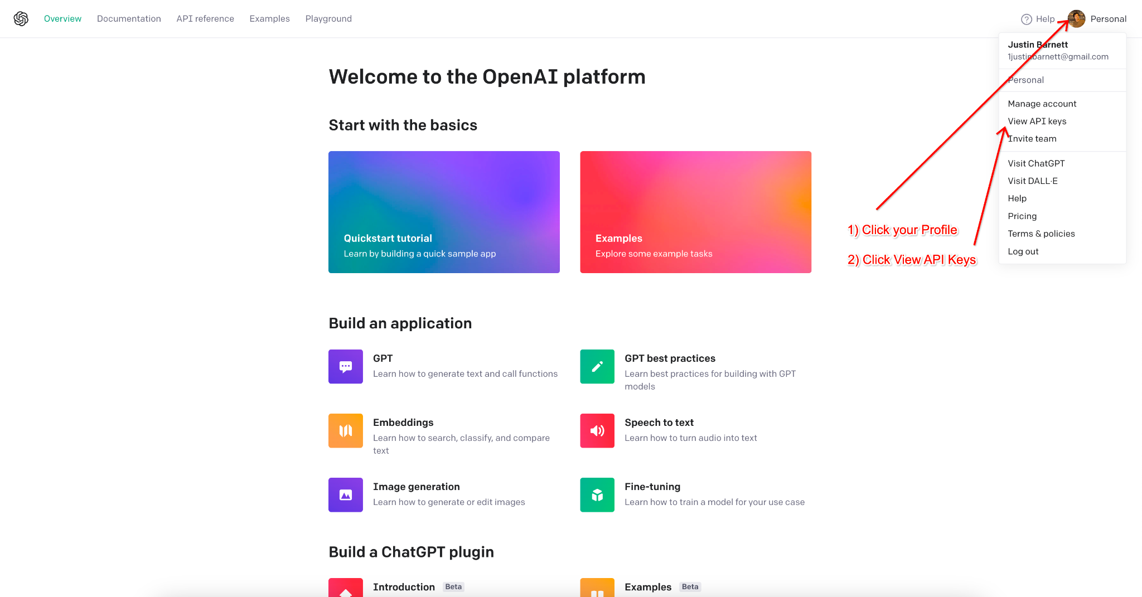
Setting Usage Limits

Slide 5
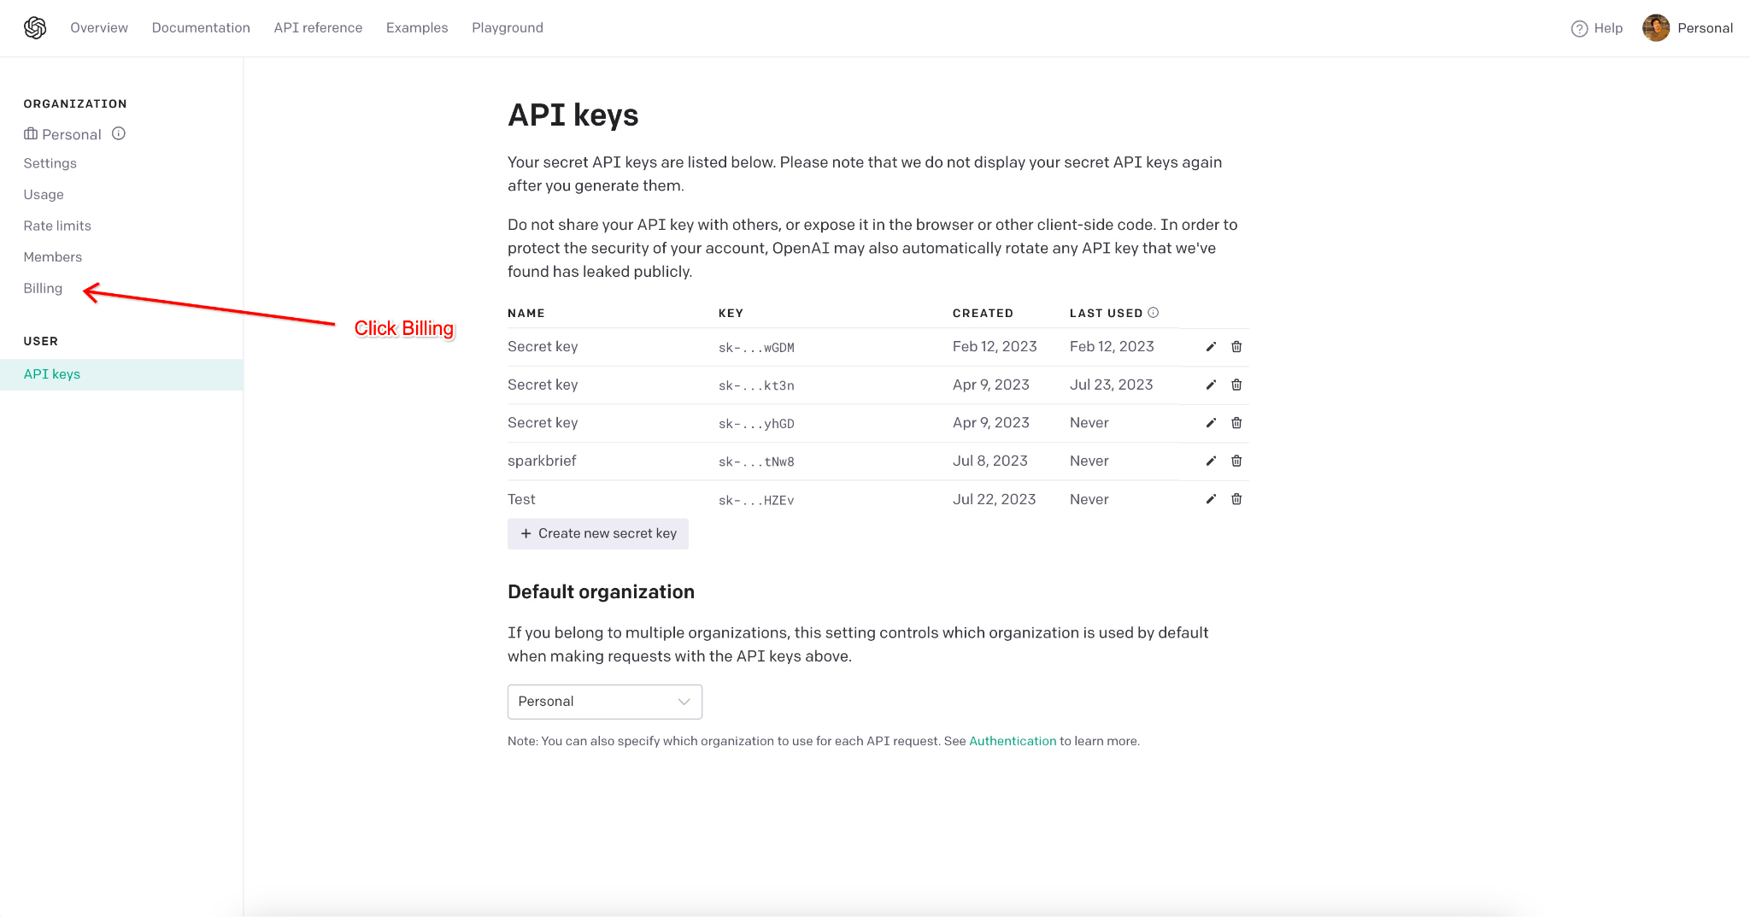
Click Billing

Slide 6
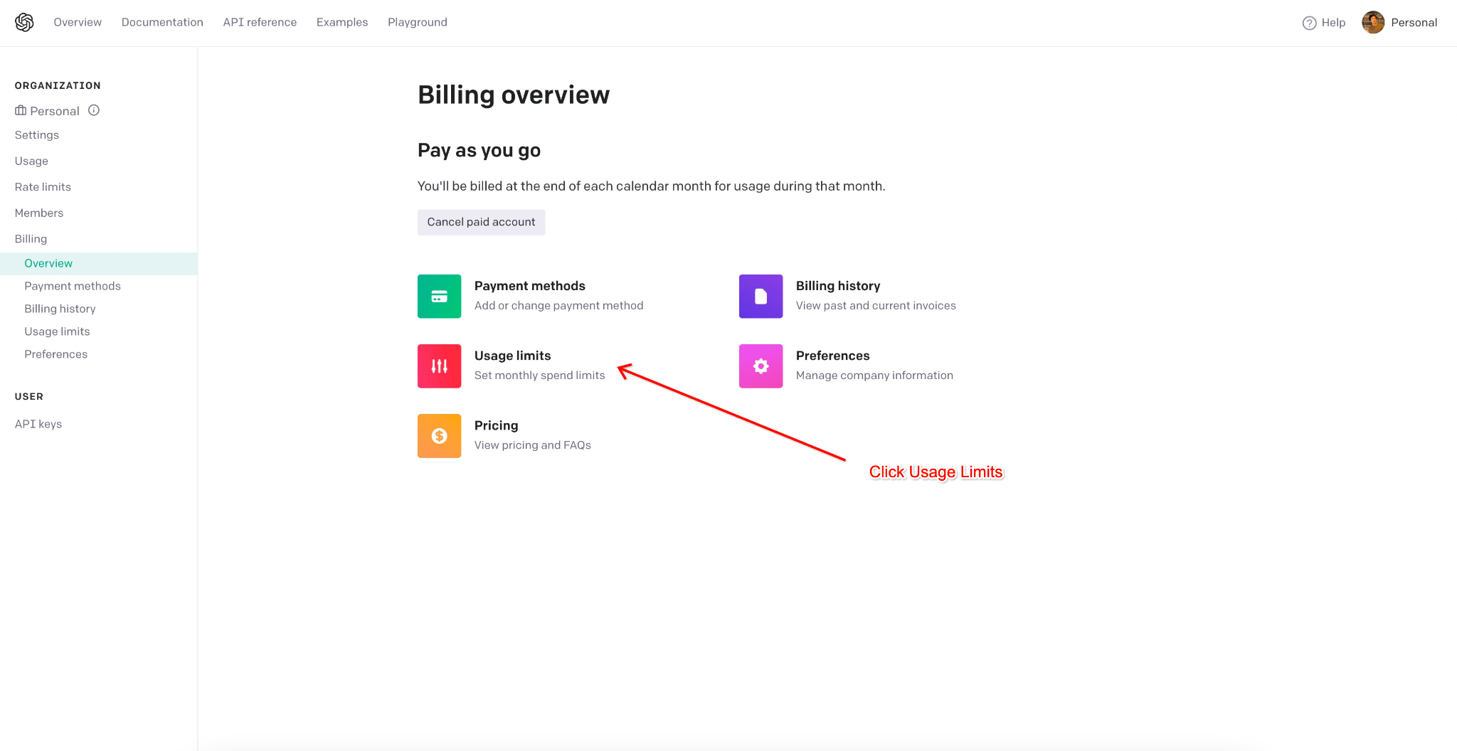
Click Usage Limits

Slide 7
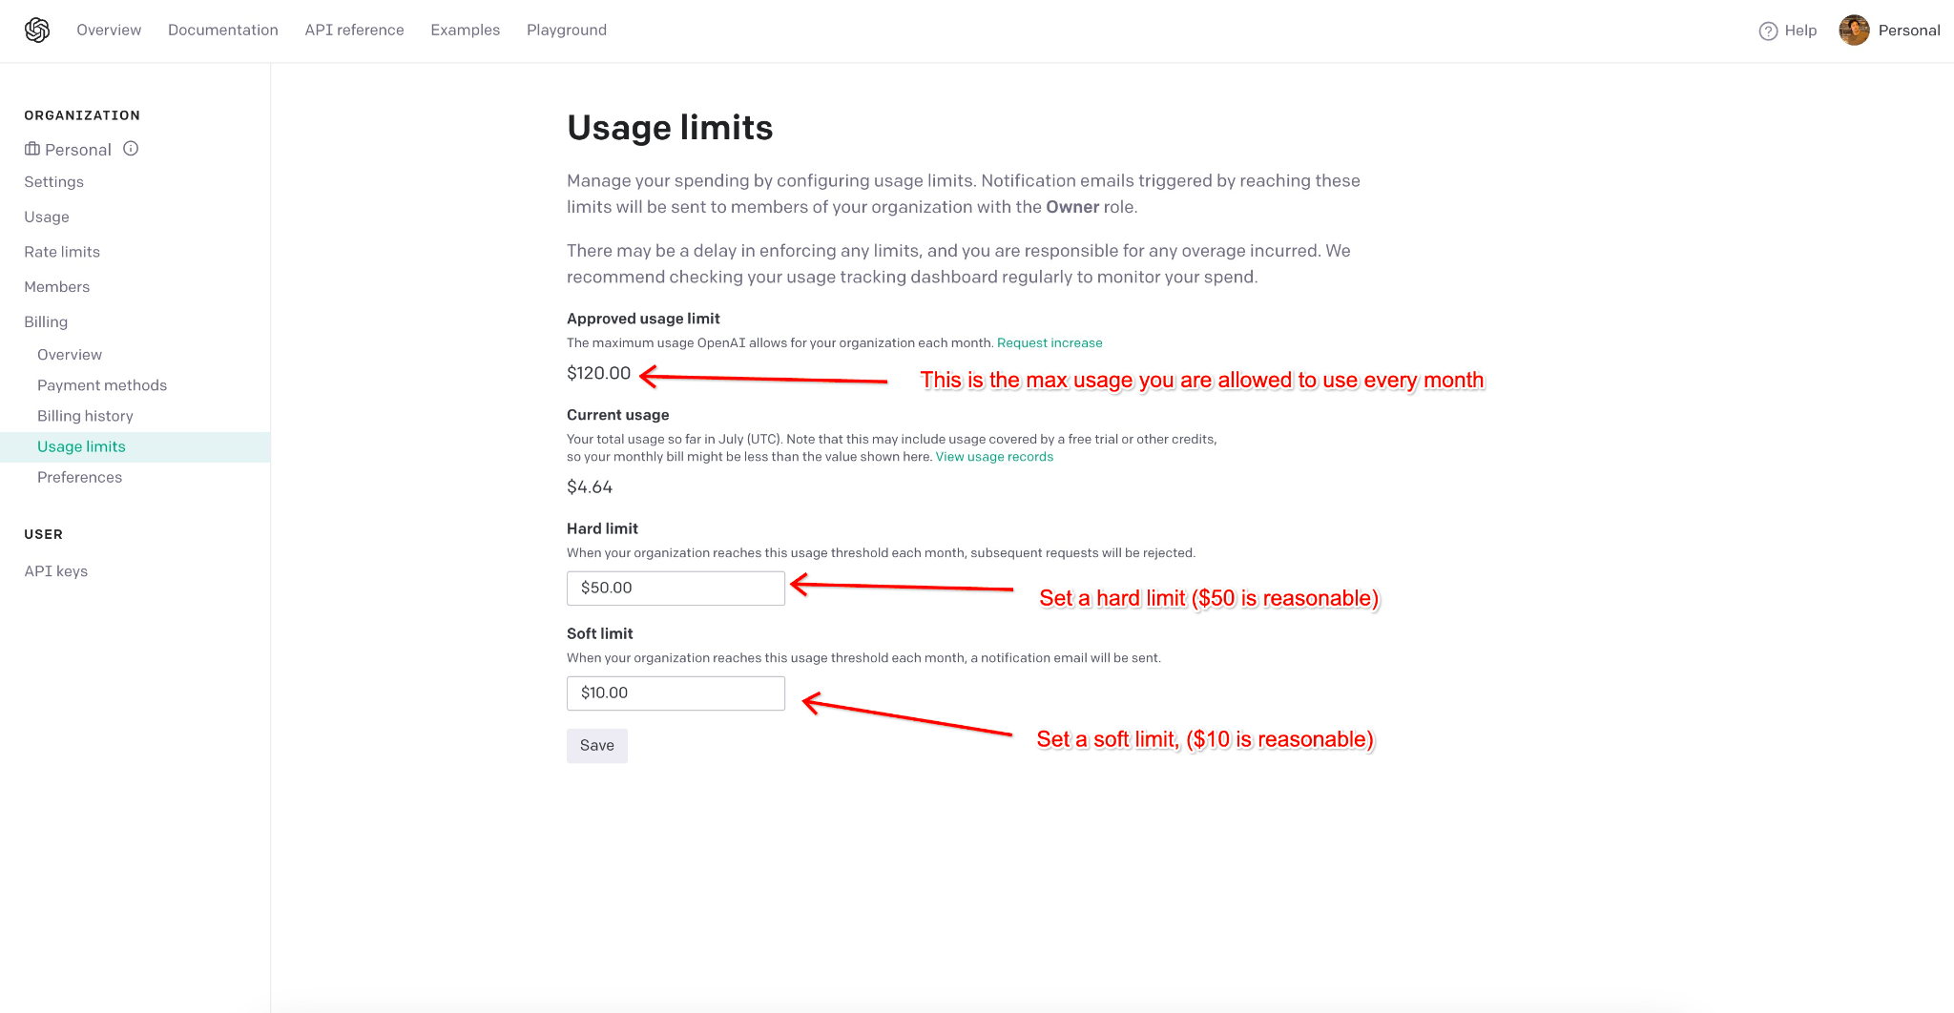
Set a soft and hard limit

